Slide 1
Pre-Defense
BanHope: Hope Speech Detection in Bengali Text
Presented by
Supervised by
Fatema Khatun
ID: 230122001
Supervised by
Chowdhury Sajadul Islam
Associate Professor & Chairman
Department of CSE
Md. Abu Sayed
ID: 230122004
Sarmin Akter Eti
ID: 230122015
Co-Supervised by
Mohammad Mehadi Hasan
Assistant Professor & Sr. Lecturer
Department of CSE
Foysal Ahamed
ID: 230122035
Md. Rajaul Islam
ID: 230122039

Slide 2
Presentation Outline
Introduction
Motivation
Objective
Literature Review
Methodology
Progress Demonstration
Novelty
Future Work
Conclusion
Pre-Defense

Slide 3
Introduction
Hope Speech Detection (HSD) is a technique that analyzes textual content to identify supportive and encouraging communication online.
Focus on analyzing Bengali social media text. A specialized Hope Speech Detection system that can understand Bengali tweets and classify them as Hope or Non-Hope.
Goal: To build an AI-based system that can automatically detect hope speech in
Bengali social media, promoting positivity, diversity, and peace online.
Pre-Defense

Slide 4
Motivation
AI Detects Hate, We’re Teaching It Hope.
Popular NLP systems detect hate speech in English and Spanish, but not in Bengali.
Existing research highlights negativity online but fails to capture the supportive and cultural context of Bengali social media.
We’re building an AI that doesn’t just filter—it amplifies positivity and hope in Bengali voices.
Pre-Defense

Slide 5
Objective
Develop a novel HSD system capable of classifying Bengali social media text into Hope and Non-Hope.
Construct the existing first Bengali Hope Speech dataset, consisting of 2,626 manually annotated tweets collected between 2021–2022 with clear Hope vs Non-Hope labels.
Ensure annotation reliability using Fleiss’ Kappa and validate corpus balance across categories.
Design and benchmark computational models, including traditional classifiers and transformer-based architectures, for accurate and robust Hope Speech detection in Bengali text.
Pre-Defense

Slide 6
Literature Review
Existing Works
NLP on social media → hate speech, emotion, humour detection.
Some datasets: Mostly focused on → negativity, not hope.
Hope Speech Datasets
Palakodety (2019) → English YouTube comments.
Chakravarthi (2020) → HopeEDI (English, Tamil, Malayalam).
Balouchzahi (2022) → English Twitter corpus (binary + fine-grained).
Pre-Defense

Slide 7
Literature Review
Limitations in Current Works
No dataset for Bengali Hope Speech.
Existing models focus on hate/abuse detection, not hope.
Most research is limited to English, Tamil, Malayalam, Spanish, Kannada.
Our Focus
Build the existing first Bengali Hope Speech dataset.
Support positivity and inclusivity in social media discourse.
Work with Bengali text to promote culturally aware NLP research.
Pre-Defense

Slide 8
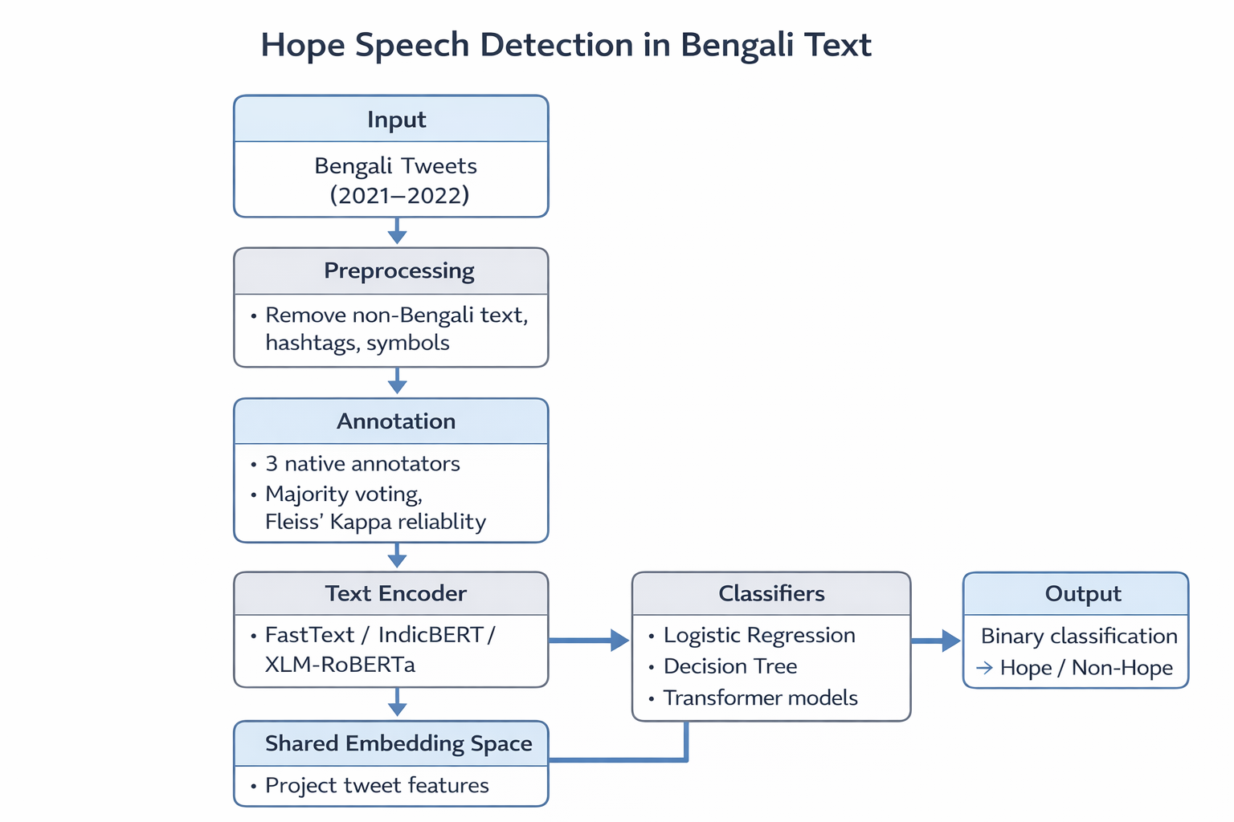
Methodology
Input: Collect Bengali tweets (2021–2022) using keywords.
Preprocessing: Remove non-Bengali text, hashtags, symbols
Annotation: 3 native annotators, majority voting, Fleiss’ Kappa reliability
Text Encoder: FastText / IndicBERT / XLM-RoBERTa
Shared Feature Space: Project tweet features
Classifier: Logistic Regression, Decision Tree, Transformer models
Output: Binary classification → Hope / Non-Hope
Pre-Defense

Slide 9
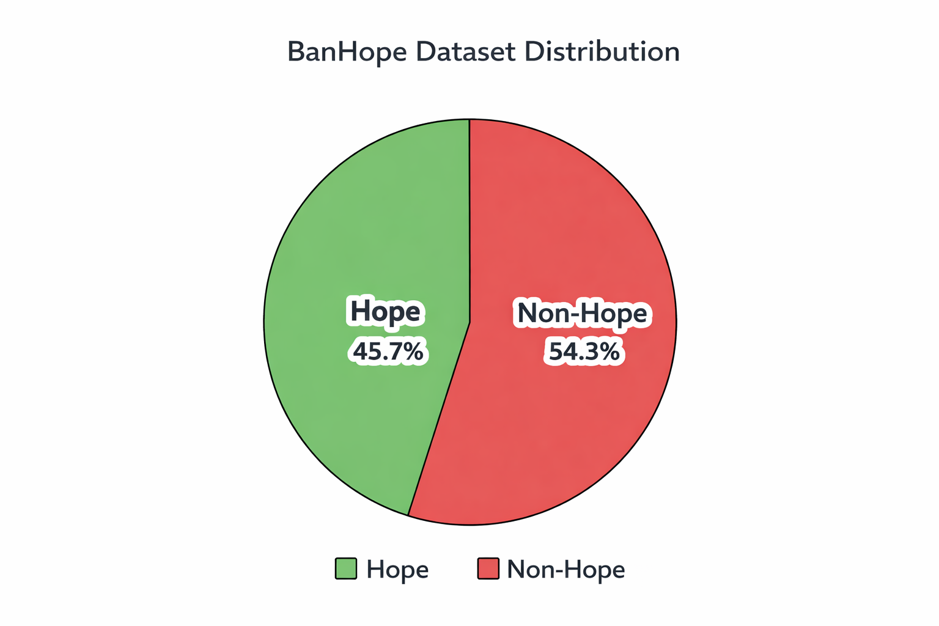
Progress Demonstration
Input: Collect Bengali tweets (2021–2022) using keywords.
Preprocessing: Remove non-Bengali text, hashtags, symbols
Annotation: 3 native annotators, majority voting, Fleiss’ Kappa reliability
Text Encoder: FastText / IndicBERT / XLM-RoBERTa
Shared Feature Space: Project tweet features
Classifier: Logistic Regression, Decision Tree, Transformer models
Output: Binary classification → Hope / Non-Hope
Example: আমরা একসাথে থাকলে সবকিছু সম্ভব। (Hope) And কোনো পরিবর্তন হবে না, সবই বৃথা। (Non-Hope)
Pre-Defense

Slide 10
Novelty
Existing first Bengali Hope Speech dataset from social media
Culturally contextual annotations reflecting local positivity
Bangla‑supported NLP with IndicBERT / XLM‑RoBERTa
Binary classification (Hope / Non‑Hope) with reliable annotation
Benchmarks comparing traditional classifiers vs transformer models
Pre-Defense

Slide 11
Future Work
Expand dataset size with more diverse sources (Facebook, YouTube, LinkedIn).
Explore fine-grained hope categories (Generalized, Realistic, Unrealistic).
Apply advanced transformer models (Indic-BERT, multilingual XLM-R, Etc.).
Cross-lingual hope speech detection across South Asian languages.
Integrate multimodal hope speech detection (text + image/video).
Pre-Defense

Slide 12
Conclusion
Introduces the existing first Bengali Hope Speech dataset curated from social media, combining culturally contextual annotations with transformer‑based NLP models.
The system effectively classifies Hope and Non‑Hope expressions in Bengali text with strong reliability and benchmarked performance. The results confirm the feasibility of culturally aware NLP for promoting positivity and inclusivity in low‑resource languages.
Pre-Defense

Slide 13

Thank You
Pre-Defense

